Slide 1

RAG en .NET con KernelMemory: From Zero to HERO
Luis Mañez

Slide 2





RAG en .NET con KernelMemory: From Zero to HERO
Luis Mañez
Chief Architect - Developer ClearPeople LTD
www.linkedin.com/in/luismanez
github.com/luismanez
twitter.com/luismanez

Slide 3

THANK YOU SPONSORS

Slide 4
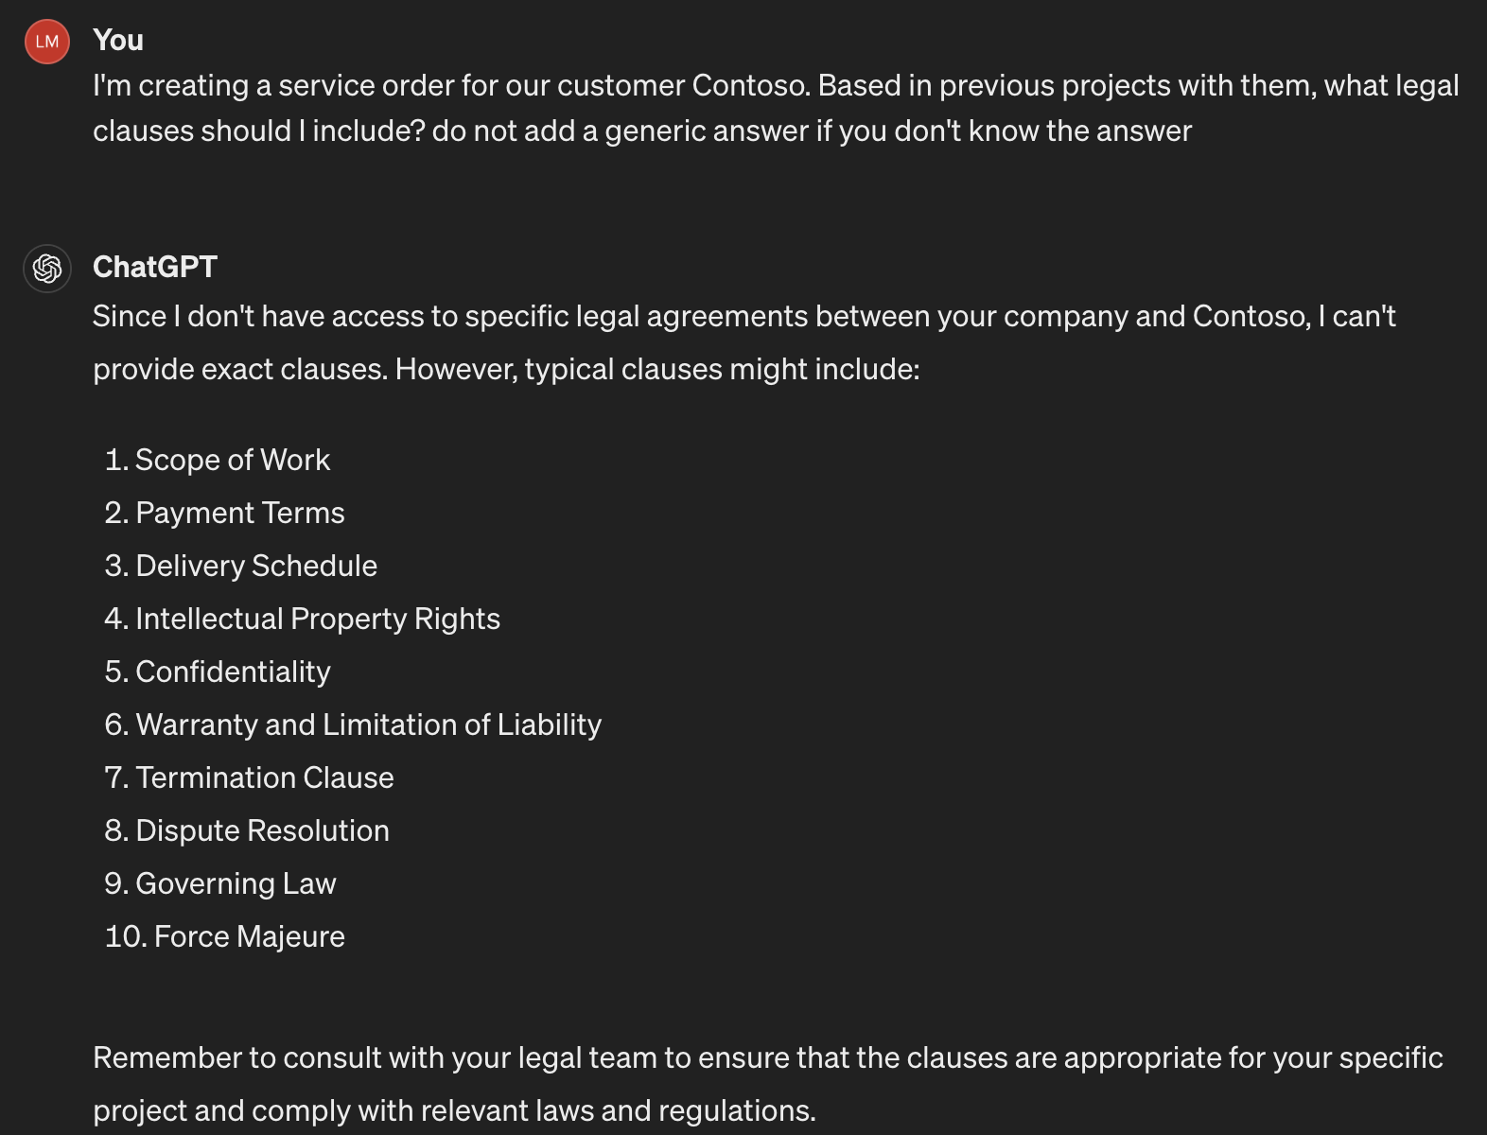
To RAG or not To RAG

Slide 5
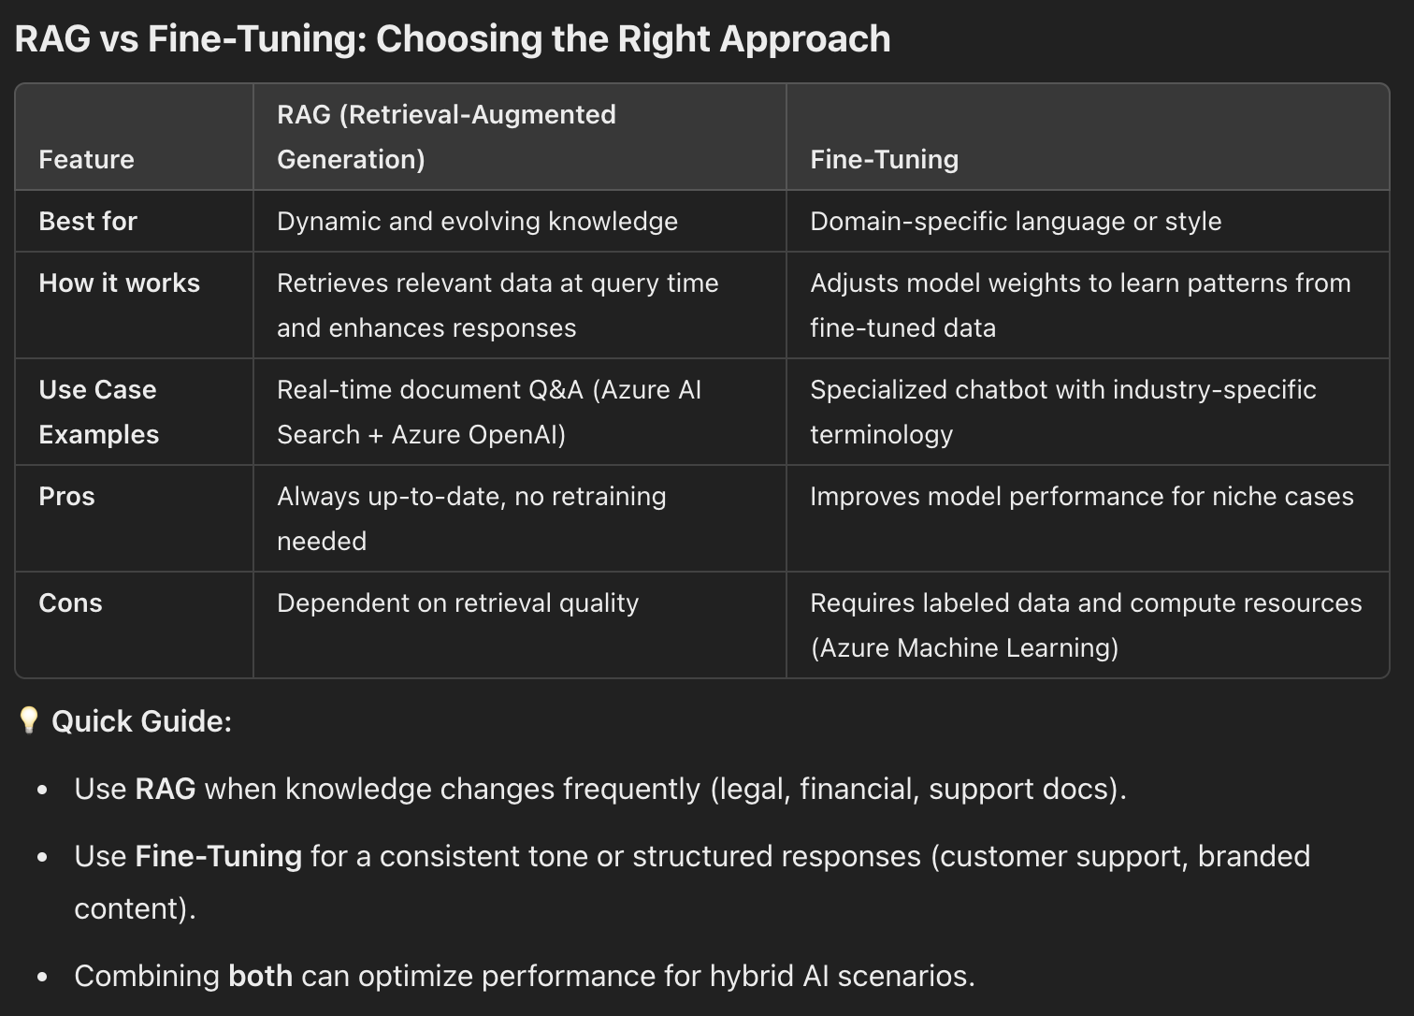
What about Fine Tuning
Fine-tuning is the process of teaching an AI model to improve its responses by training it on specialized examples. It helps the model learn specific language, tone, or patterns for a particular industry or use case, making its answers more accurate and relevant.

Slide 6

What about Fine Tuning

Slide 7


Retrieval – Augmented - Generation
Retrieval
Augmented
Generation
Context
Based on previous service orders with Contoso you should add the following legal clauses:
Scope of Work
Payment Terms
Delivery Schedule
Contoso Service order 1
Contoso Service order 6
I'm creating a service order for our customer Contoso. Based in previous projects with them, what legal clauses should I include?
Arkham Service order 9

Slide 8
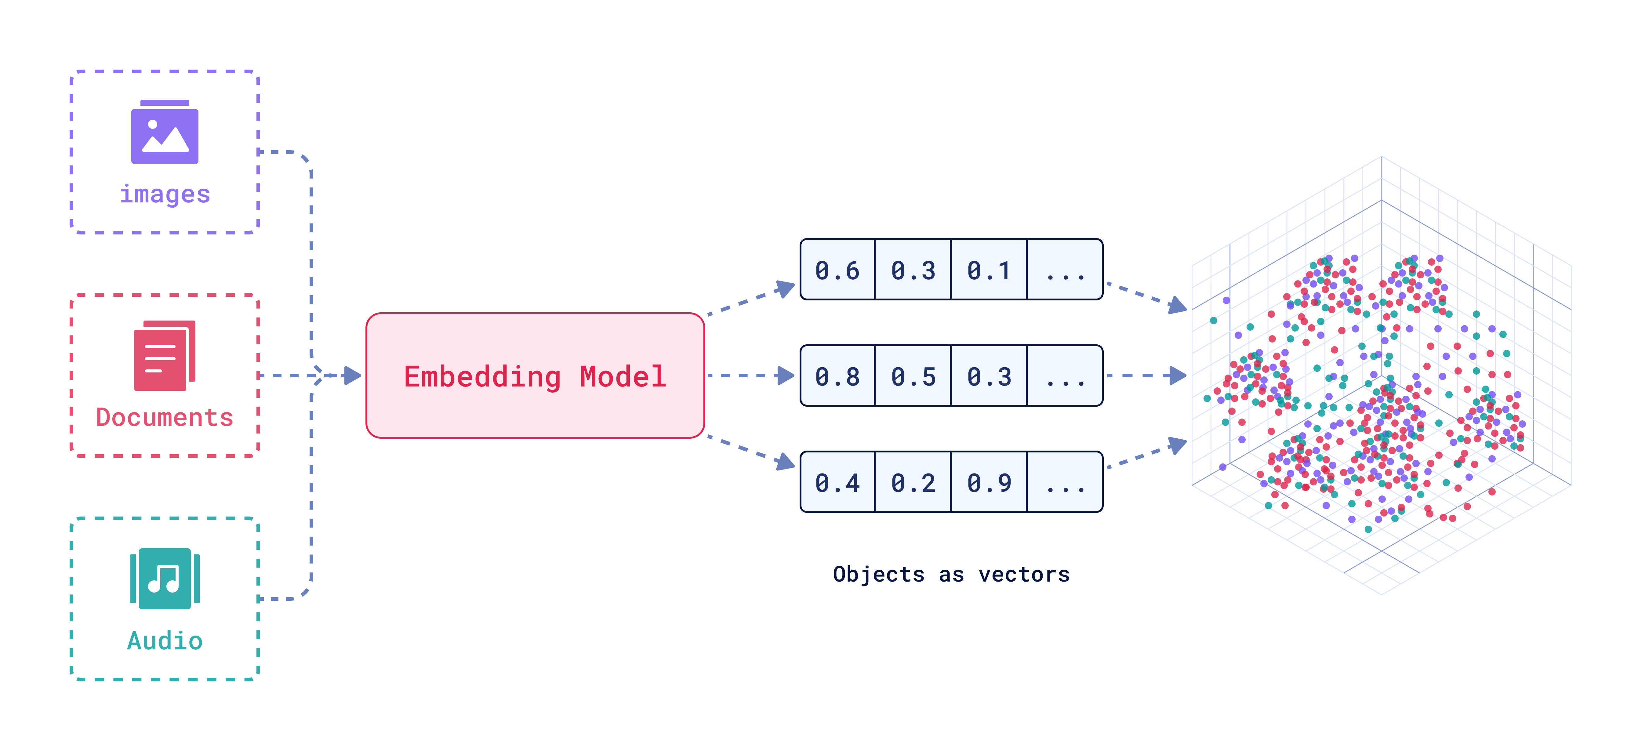
Embeddings

Slide 9









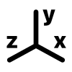













RAG Deep Dive
Documents Storage
Indexing
Text extraction
Chunking
Embeddings
Index
[-0.004828, -0.02983]
[-0.004828, -0.02983]
Chunk payload
[-0.004828, -0.02983]
Chunk Embeddings
[-0.004828, -0.02983]
Plain text
[-0.004828, -0.02983]
Metadata
………….
Retrieve
Generation
Context
[-0.004828, -0.02983]
payload + metadata 1
User query
[-0.004828, -0.02983]
[-0.004828, -0.02983]
payload + metadata 2
[-0.004828, -0.02983]
payload + metadata 3
User query

Slide 10
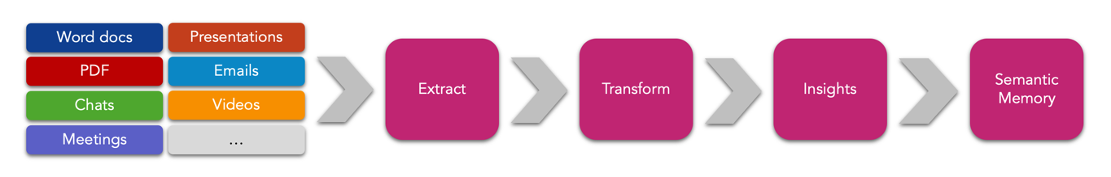
Kernel Memory
RAG in .NET solutions made easy
Open-Source library: https://github.com/microsoft/kernel-memory
Integrated with Semantic Kernel
Works serverless or as an independent web service
Supports multiple vector DBs (Azure AI Search, Redis, Qdrant, Postgres, MongoDb)
Supports multiple LLM Models (OpenAI, Azure OpenAI, Llama)

Slide 11
RAG Deep Dive
Documents Storage
Indexing
Text extraction
Chunking
Embeddings
Index
[-0.004828, -0.02983]
[-0.004828, -0.02983]
Chunk payload
await memory.ImportDocumentAsync("Data/expenses.xlsx");
[-0.004828, -0.02983]
Chunk Embeddings
[-0.004828, -0.02983]
Plain text
[-0.004828, -0.02983]
Metadata
………….
Retrieve
Generation
Context
[-0.004828, -0.02983]
payload + metadata 1
User query
[-0.004828, -0.02983]
[-0.004828, -0.02983]
payload + metadata 2
var answer = await memory.AskAsync(query);
[-0.004828, -0.02983]
payload + metadata 3
User query

Slide 12


Show me the code !!

Slide 13

https://github.com/luismanez/global-ai-barcelona-2025

Slide 14

More resources
https://github.com/luismanez/collabdays-madrid-2024
https://github.com/microsoft/kernel-memory
https://learn.microsoft.com/en-us/azure/search/retrieval-augmented-generation-overview
https://www.youtube.com/live/maP9lgTOwmM?si=rNwZdrXGRUqlyyf_

Slide 15
THANK YOU SPONSORS

Slide 16

Thank you

